Slide 1
Optimizing Classroom Scheduling: A Data-Driven Dashboard
Linga Adithya K (22MIA1002)
Kumaraswamy G (22MIA1133)

Slide 2
CONTEXT
Inefficient classroom scheduling is a common issue, leading to underutilized rooms and overutilized rooms.

Slide 3


Introduction
Purpose: Develop an interactive dashboard to analyze current usage, predict future demand, and provide actionable scheduling recommendations.
Motivation: Aims to save resources, improve student access, and enhance faculty planning.
Tools Used: Built with Python for data processing, Streamlit for the interface, Prophet for forecasting, and Plotly for visualizations.

Slide 4
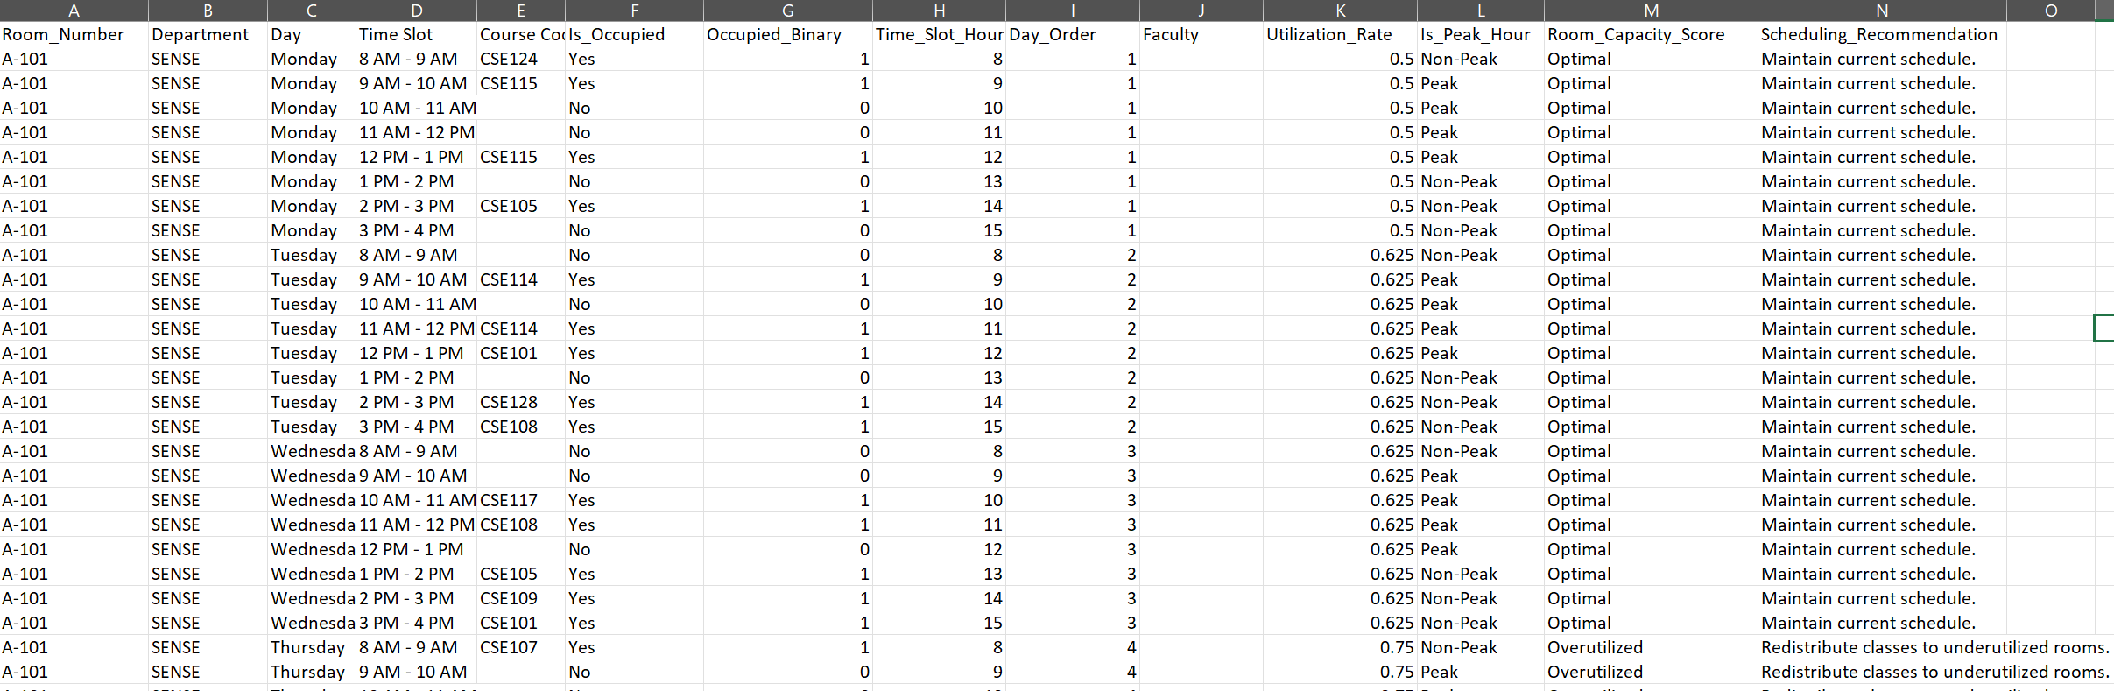
Dataset Overview
Source: class_utilization.csv
Key Data: Rooms, Days, Time Slots, Occupancy.
Preprocessing: Added Is_Peak_Hour, Utilization_Rate

Slide 5
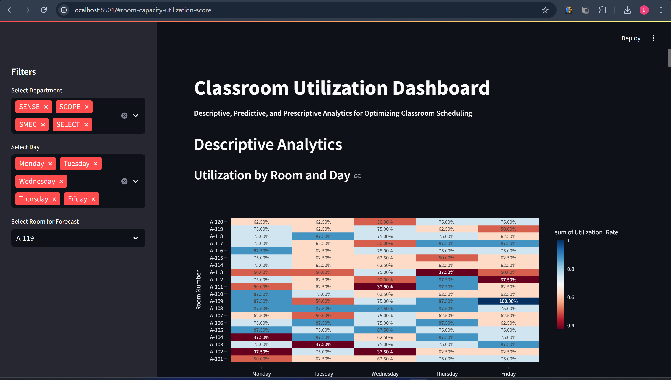
Dashboard Overview
Platform: Developed using Streamlit, enabling an interactive web-based interface.
Interactivity: Features sidebar filters for Department (multi-select), Day (multi-select), and Room (dropdown for forecasts).
Analytics Types:
Descriptive: Analyzes current utilization patterns.
Predictive: Forecasts future utilization trends.
Prescriptive: Offers data-driven scheduling suggestions.

Slide 6
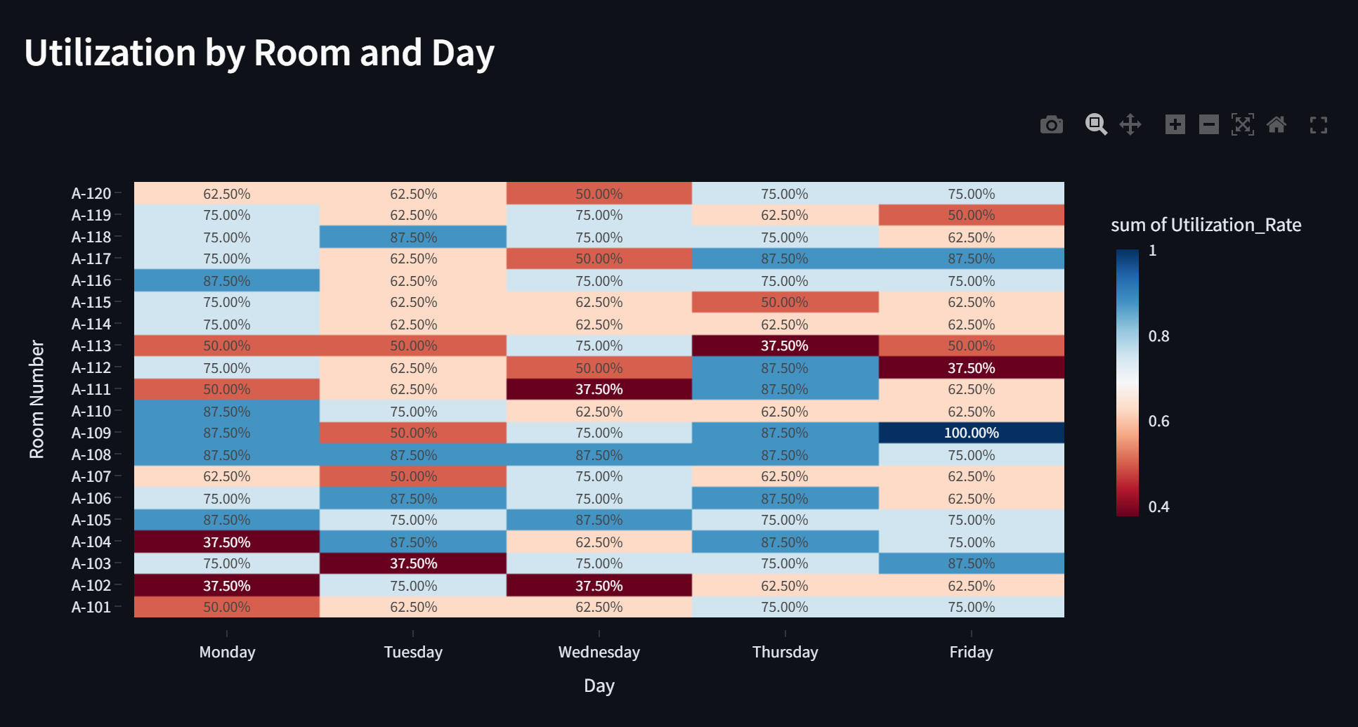
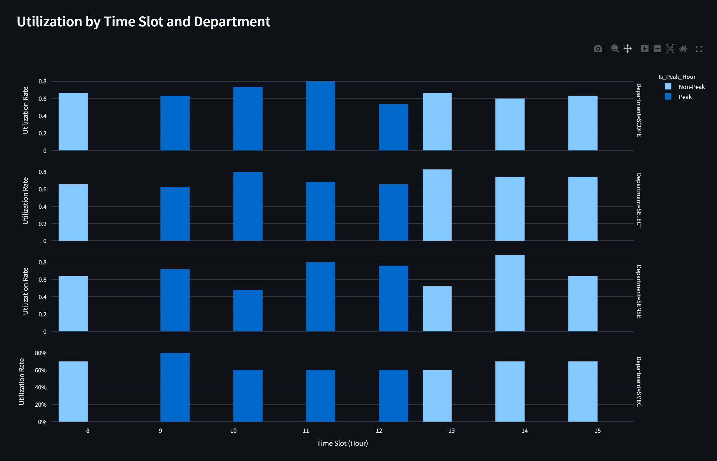
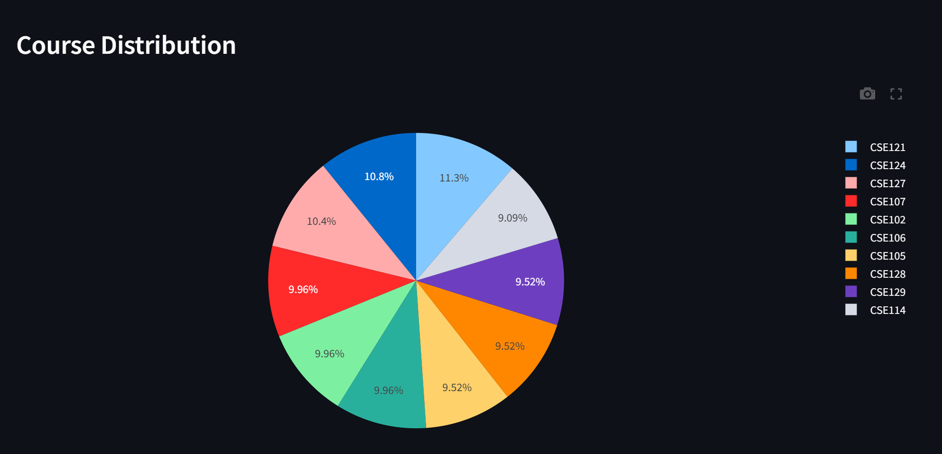
Descriptive Analytics
Heatmap: Displays utilization rates by Room and Day.
Example: Room A-108 shows 80% utilization, indicating overbooking; A-111 shows <30%, suggesting underuse.
Bar Chart: Shows utilization by Time Slot and Department, highlighting peak hours (9 AM–12 PM) with higher occupancy.
Insight: Peak hours are busiest across all departments.
Pie Chart: Illustrates the distribution of the top 10 courses, revealing popular classes.

Slide 7
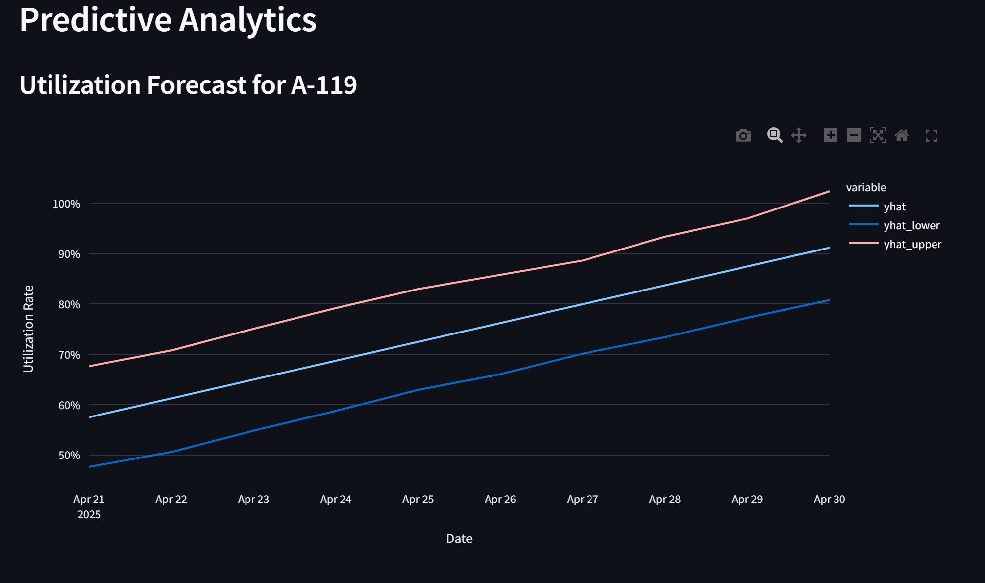
Predictive Analytics
Methodology: Utilizes Prophet, a time-series forecasting tool, to predict utilization for 5 days starting April 26, 2025.
Key Outputs:
yhat: The predicted utilization rate
(central estimate).
yhat_lower and yhat_upper: 95%
confidence interval bounds.
Example Insight: For Room A-101, forecast predicts 60% utilization on April 27, with a range of 50%–70%, indicating moderate demand with some uncertainty.
Application: Helps anticipate future needs and adjust schedules proactively

Slide 8
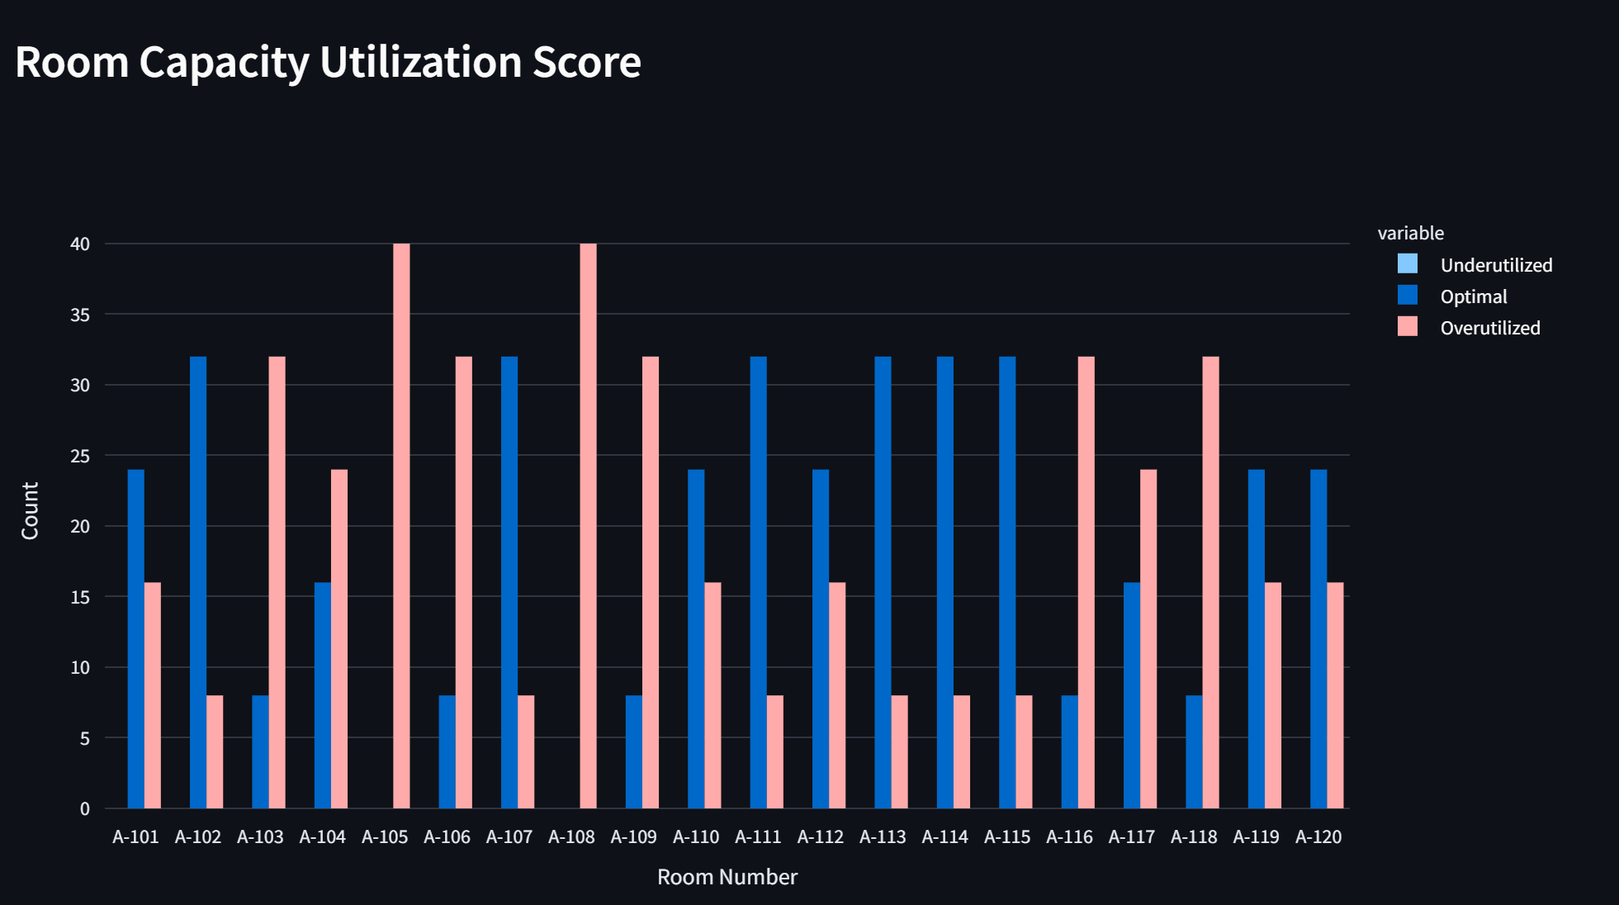
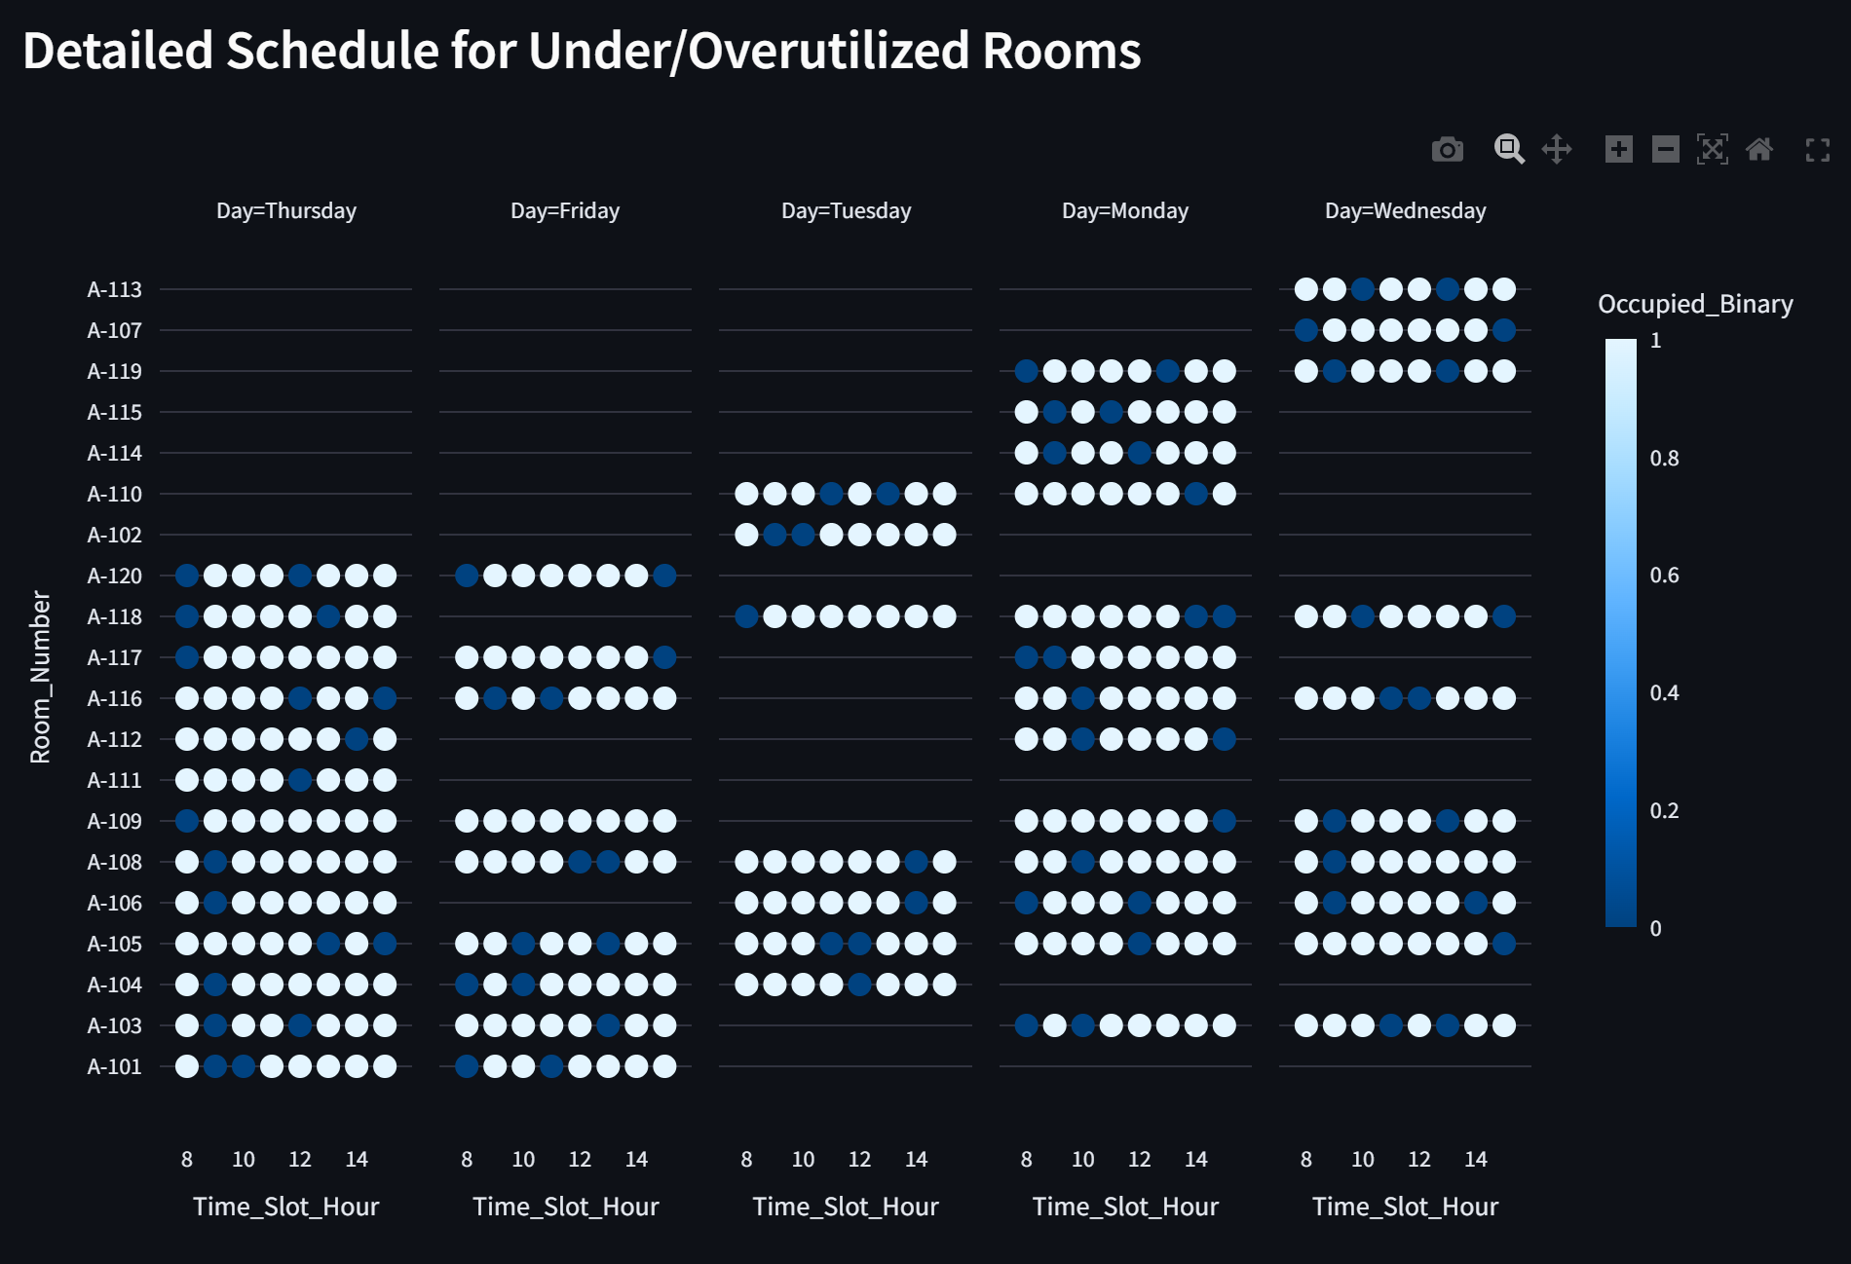
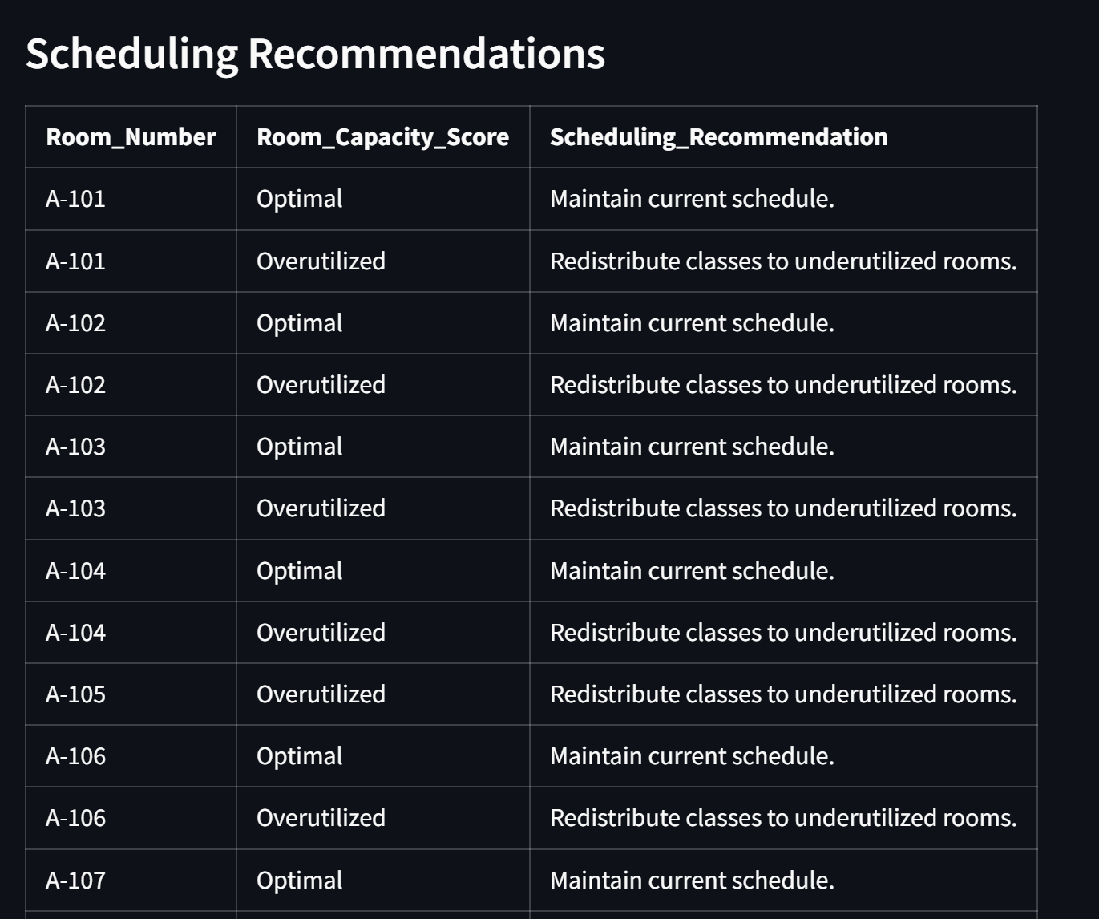
Prescriptive analytics
Room Capacity Score: Categorizes rooms based on utilization:
Underutilized (<30%)
Optimal (30–70%)
Overutilized (>70%)
Recommendations:
Example: Schedule additional classes in A-111 (Underutilized).
Example: Move classes from A-108 (Overutilized) to other rooms.
Gantt Chart: Visualizes schedules for under/overutilized rooms, aiding detailed planning.

Slide 9
Conclusion
Summary: Developed an interactive dashboard that analyzes classroom utilization, predicts future trends, and provides actionable recommendations.
Impact: Offers a practical tool to optimize scheduling, save resources, and improve educational efficiency.

Slide 10
Thank you

